Slide 1
Arcball Technique
Flavia R. Cavalcanti
Com S 437

Slide 2
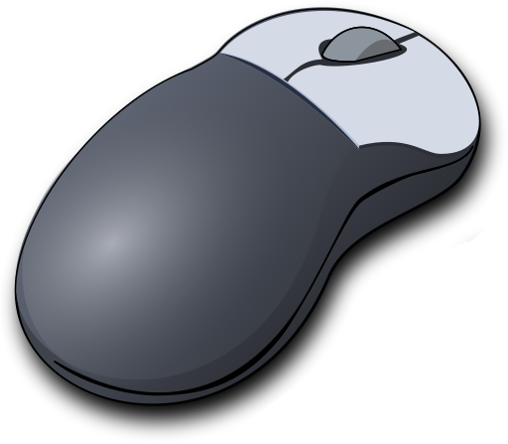
What can we do with it?
Goal: Implement an algorithm to rotate an object, using the Arcball paradigm
Input: Mouse movement
Output: a rotation matrix for a 3D object

Slide 3
Demo
Let’s first see what arc ball can do before digging into the theory…
Go demo go!

Slide 4

Why is it useful?

Slide 5
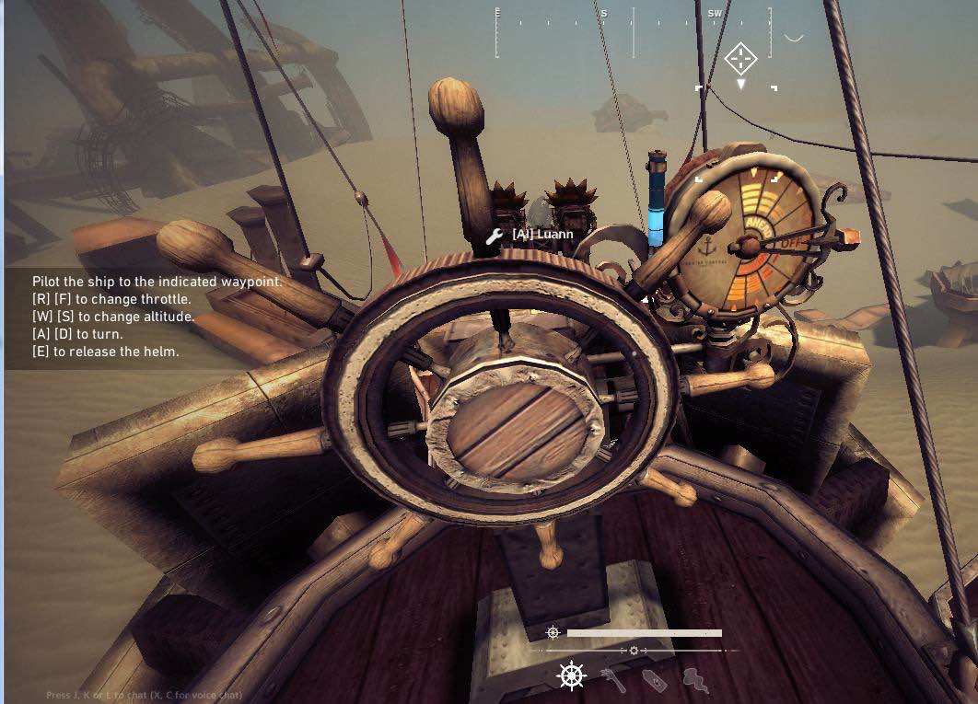
Convoluted Controls
Those are 6 keys for movement!

Slide 6
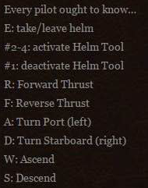
Those Controls Get Worse…
Every pilot ought to know…
That you have 5 action keys.
That you have 6 movement keys.
And as such...
You have to deal with 11 keys simultaneously per game!

Slide 7
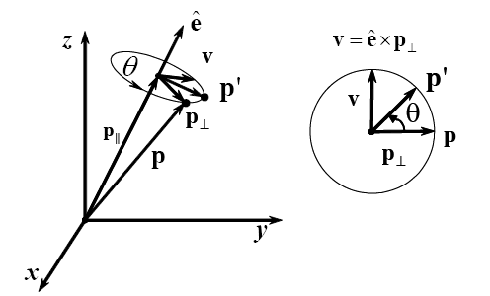
Rotating Around Vector ê ^{[2]}
P’ is described as an orthogonal base

Slide 8
Rotation Matrix
z
ê
θ
Rotation about an axis.
OpenGL - glRotatef(θ, ex, ey, ez)
Rotation matrix, after changing coordinate system from to x,y,z:
Columns of M are given by: p’(1,0,0), p’(0,1,0), p’(0,0,1)
ê – axis of rotation
θ – rotation angle
y
x

Slide 9
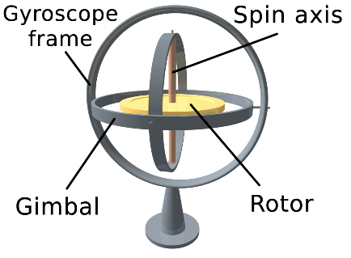
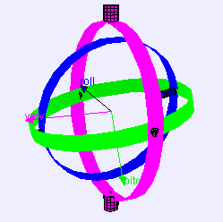
Gimbal Lock ^{[3]}
Loss of one degree of freedom in a 3D, 3-gimbal mechanism
Occurs when the axes of 2 gimbals are driven into a parallel configuration -> locking the system into place
Gyroscope with 3 gimbals
Gimbal with roll, pitch, and yaw axis

Slide 10
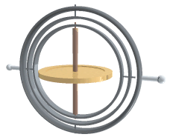
Gimbal Lock Sucks When You’re in Space ^{[5]}
Problems with Apollo 13
Apollo used an Inertial Mechanism Unit for navigation, same as airliners do today.
Given a starting point, such a system can record where you are in relation to that point at any time. Each gyroscopes will have a "null point“, where the gyro lines up perfectly with its gimbals. If all three enter this state at once, the platform instantly loses it knowledge of where it is. It goes into "gimbal lock".

Slide 11
Gimbal Lock In CG ^{[4]}
Bad Analogy – problem only occurs with Euler angles
Blender and Maya use three numbers, R_{x}, R_{y}, R_{z,} instead of a 4 dimensional array (quaternion) to store a rotation.
A general rotation R is then calculated, by multiplying these three matrices (or, some say, applying three “rolls”):

Slide 12
Euler Angles and Gimbal Lock ^{[10]}
If the y-roll happens to be 90º, then the “lock” occurs:
Loss of freedom in the y - axis

Slide 13
How to avoid Gimbal Lock?
Lock occurs because Euler angles are being changed, in a fixed order, one at a time, so axes can line up.
Another possibility is using a “fourth gimbal”, not allowed to align, which take us to a…
Better solution-> quaternions.

Slide 14
Sir Rowan William Hamilton
Hamilton, in 1830, tried to generalize complex numbers to R³ (a complex volume, with two imaginary axes)
a + ib, i² = -1
He realized in 1843 that it was impossible on R³ (triples of numbers are not closed under multiplication), but not on R⁴ or R⁸
q = a + bi + cj + dk = (a,v), i² = j² = k² = ijk =-1
ij = k, jk = i, ki = j, kj = -i = ji = -k, ik = -j
The multiplication of two quaternions is a quaternion
Closed under multiplication => mathematical group.
Quaternion multiplication is not commutative! q₁.q₂ ≠ q₂.q₁

Slide 15
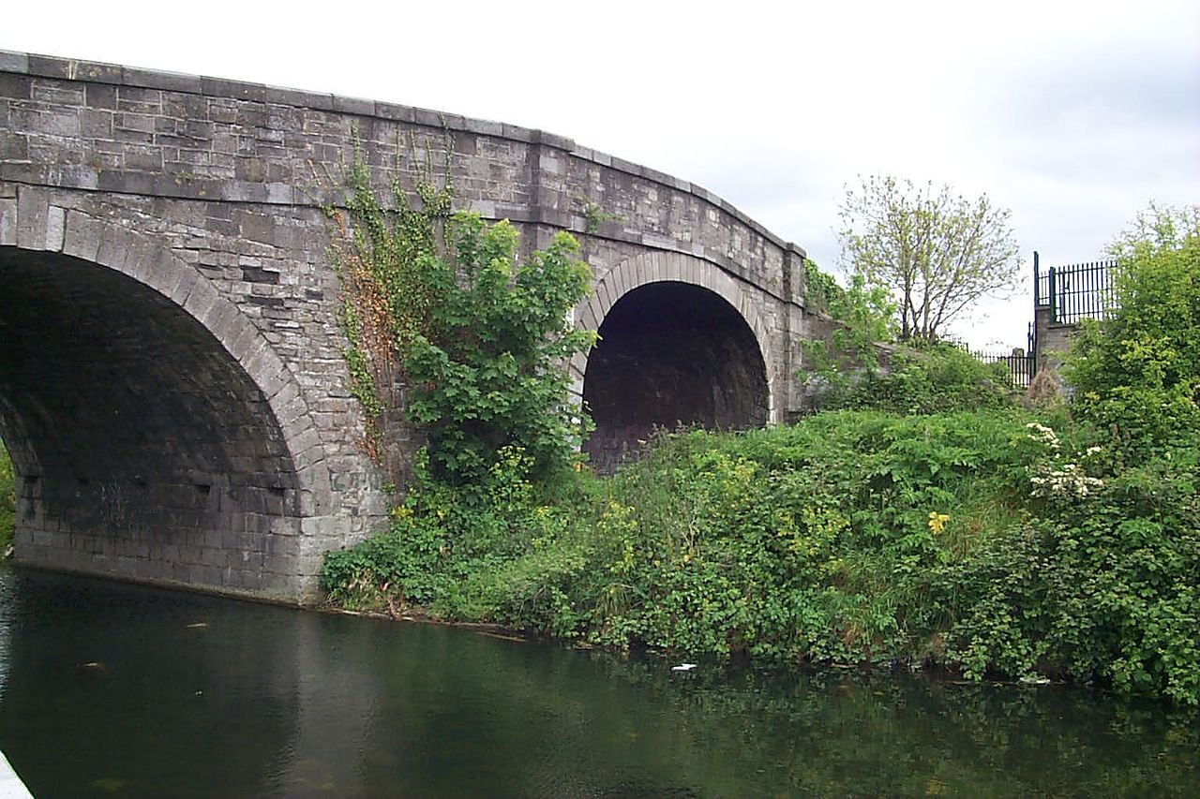
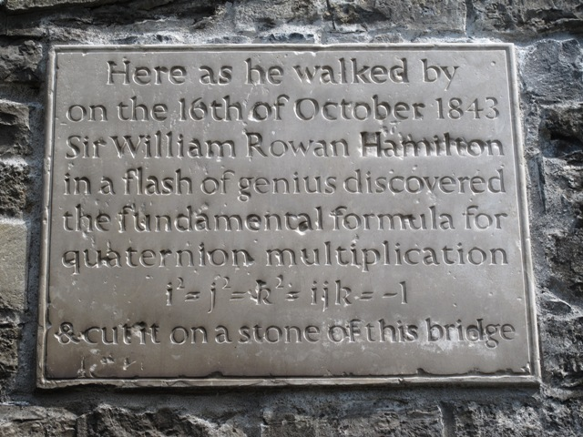
Broome Bridge in Dublin ^{[6]}

Slide 16
Quaternions ^{[2]}
Complex Numbers on R⁴
q = a + bi + cj + dk
q = (s, v),
s – real component and
v – vector representing the imaginary component
Simplifies the calculation of rotations about an axis
Rotations using product of quaternions
Rotation of a point p about an axis v
R(p) = q p q ⁻¹
p = (0, r ) - point represented as a pure quaternion
q = (s, v ) - rotation (angle and axis) represented as a quaternion
ê – unit vector (rotation axis)
θ – rotation angle

Slide 17
Properties of Quaternions ^{[2]}
Multiplication and Addition
Conjugate and reciprocal:
Norm:
Rotation: take a pure quaternion p = (0, r) and a unit quaternion q=(s,v), where , and define:
R(p) = q p q ⁻¹

Slide 18
Orientations as Quaternions ^{[2]}
This is exactly the same equation in transparency 4
aside from a factor of 2, and p written as r
Therefore, orientations can be parameterized as:

Slide 19
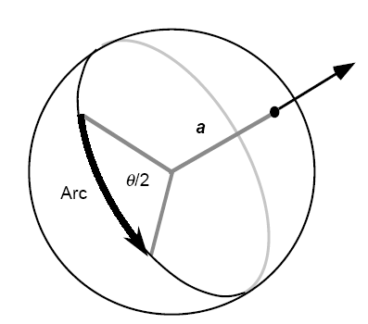
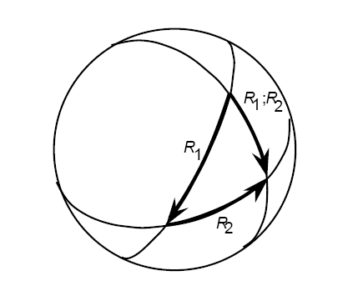
ArcBall Technique
Interface to rotate a 3D object using just a mouse
Arc Interpretation
a – rotation axis
θ – rotation angle
Arc Combination

Slide 20
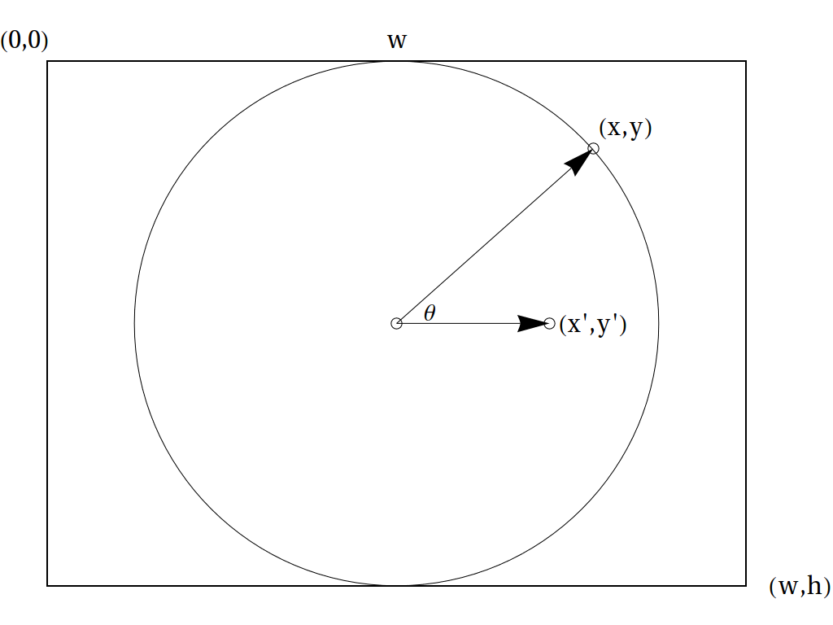
Sphere As a Virtual Trackball ^{[7]}
Consider screen coordinates from (0,0) to (w,h).
Mouse coordinates (x,y) are used to sample a function, z(x,y):
Points inside the circle are mapped onto a sphere, while points outside are mapped onto plane z=0.

Slide 21
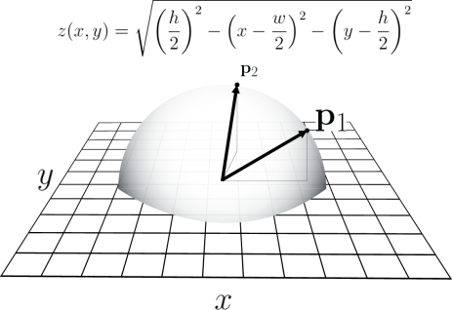
Hemisphere Inscribed in Screen Area ^{[7]}
Circle centered at the origin:
Circle centered at (w/2, h/2):

Slide 22
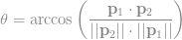
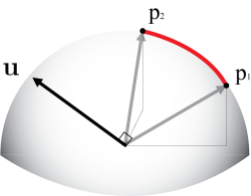
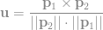
Angle-axis Transformation ^{[7]}
Mouse dragged from to
Rotation angle:
Rotation axis:

Slide 23
Rotation as Two Reflections ^{[8]}
Practical implementations use two reflections instead of a rotation
Product of two reflections in intersecting planes is equivalent to a rotation.
The axis of this rotation is the line of intersection of the planes, while the angle of rotation is twice the angle between the two planes.

Slide 24
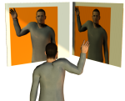
Example ^{[8]}
Put two mirrors at 90° to each other and put an object in front of them.
The reflection on the second mirror will appear to have been rotated by 180° relative to the original object.
The rotation angle 180° is twice the angle between mirrors, which is 90° in this example.

Slide 25
Simple-Rotator.js ^{[10]}
setView = function( viewDirVec, viewUpVec, viewDistance )
Create view matrix using (u_{x,} u_{y,} u_{z}) as column vectors
viewDirectionVector --> u_{z}
viewUpVector x u_{z} --> u_{x}
u_{z} x u_{x} --> u_{y}
getViewMatrix = function()
Return a rotated view matrix (after dragging the mouse)
function toRay(x,y)
Create a ray from the center of the screen to the point on the sphere, which projects onto (x,y)
Sphere origin is the center of screen, and radius is the minimum (width, height)

Slide 26
Simple-Rotator.js ^{[10]}
function doMouseDrag(evt)
Create two rays: ray₁,ray₂
map them to world coordinates, by using the view matrix inverse (transpose)
applyTransvection(ray₁,ray₂);
function applyTransvection(e₁, e₂)
Rotate view matrix (u_{x,} u_{y,} u_{z}) around (e₁ x e₂), by applying two reflections on each vector.

Slide 27

That’s All Folks
Questions?

Slide 28
References
[1] ARCBALL: A User Interface for Specifying Three-Dimensional Orientation Using a Mouse - Ken Shoemake
[2] Advanced Animation and Rendering Techniques – Alan Watt
[3] https://www.youtube.com/watch?v=zc8b2Jo7mno
[4] https://sundaram.wordpress.com/2013/03/08/mathematical-reason-behind-gimbal-lock- in-euler-angles/
[5] http://www.universetoday.com/119984/13-more-things-that- saved-apollo-13-part-9-avoiding-gimbal-lock/

Slide 29
References
[6] https://www.youtube.com/watch v=mHVwd8gYLnI&nohtml5=False
[7] https://braintrekking.wordpress.com/2012/08/21/tutorial-of-arcball- without-quaternions/
[8] https://sureshemre.wordpress.com/ 2014/07/19/a-rotation-equals-two- reflections/
[9] http://math.hws.edu/eck/cs424/notes2013/webgl/ skybox-and-reflection/simple-rotator.js
[10] http://en.wikipedia.org/wiki/Euler_angles

